Slide 1
Alternative Delivery Systems in rural Alaska
A Master’s Project by:
Katrina Monta
2015
Notes:
Name
Masters Project
Graduate 2015

Slide 2
Overview
Alaska’s uniqueness & challenges
Project Delivery systems
Traditional vs. Alternatives
Case Studies – Alaskan Projects
Issues of Traditional Project Delivery
Conclusions: Bridge Project Delivery System
Notes:
Go through outline:
Alaska – difficult/unique
DBB, DB, CMAR
Case Studies
What I think will help

Slide 3
Alaska’s Uniqueness & Challenges
Transportation
Weather & Climate Zones
Seasons
Resources & Availability
Notes:
Talk about Alaska:
Transportation – air, barge, train, freight, mail, ice roads, frozen rivers
Weather: Shorten seasons/Lengthened seasons, Different climates & terrains, rainforests, tundra, coastal, mountainous
Resources: have to ship in or already have gathered, no going to walmart out in the bush

Slide 4
Project delivery systems
Traditional – Design-Bid-Build
Alternative Delivery Systems
DB – Design-Build
CM@R – Construction Manager at Risk
Notes:
Looking at the traditional vs. alternative

Slide 5
Pros & cons
Design Build
Traditional
CM@R
*Photo credit – Pete Bellezza, CRW Engineering Group, LLC.
** Project Delivery Systems: Pro vs. Con Design-Bid-Build vs. CM @ Risk vs. Design-Build (n.d.): n. pag. CMAA California
Chapter. Web. 25 Oct. 2015.
Notes:
Traditional – Pros: all information is gathered before the contractor is selected and most of the ‘issues’ are thought about prior. Cons: Slow, very linear, no beginning with contractor input
Design-Build: Pros: One contract (one entity does design and construction) all risk transferred, cost control. Cons: minimal owner control of design, no one to represent owner, fewer bidders
CM@R: Pros: CM takes responsibility for construction and some risk, ability to fast-track. Cons: potential conflict of interest, reduced control of construction

Slide 6
Case studies
CRW Engineering Group, LLC. – Anchorage, Alaska
Marble Construction – Ketchikan, Alaska
Steppers Construction, Inc. – Wasilla, Alaska
Ketchikan Indian Community – Ketchikan, Alaska
F&W Construction Company, Inc. - Anchorage, Alaska
Arctic Slope Regional Corporation – Anchorage, Alaska
Alaskan Experiences:
David Barnes
Billy Connor
James Monta
Horacio Toniolo
Notes:
These case studies were complied to analyze how projects have been conducted in alaska and experiences of working in remote places.

Slide 7
Project & Experience locations
Sagavanirktok River
Port Clarence
Ruby
Anchorage
Illiamna
Cordova
St. Paul Island
Attu Island
Ketchikan
Prince of Wales
Notes:
Ketchikan – KIC built elder housing – two phase bidding – low bid on architect, engineer – QBS for contractor
POW – Marble Construction – low bid – install video tower on Harris River
Anchorage – CRW – Upgrades to wastewater lift stations for Municipality of Anchorage - Anchorage Water & Wastewater Utility – DBB
Illiamna – Steppers – Office for INN Electric – DBB
Experiences: Daddy – attu/st. paul/ port clarence/ cordova (early 2000s for USCG)
Toniolo – sag river 2014-2015 (after road floodings)
Barnes – ruby/ western alaska since 2004

Slide 8
Concerns & Issues
Reasons why DBB has been used:
Traditionally used
Ability to design what owner and end-user need prior to bid
Scheduling and Permitting done previous to bid
High competition by choosing low-bid
Concerns & Issues:
Project takes a long time to go from start to finish
Material lead times
Mobilization

Slide 9
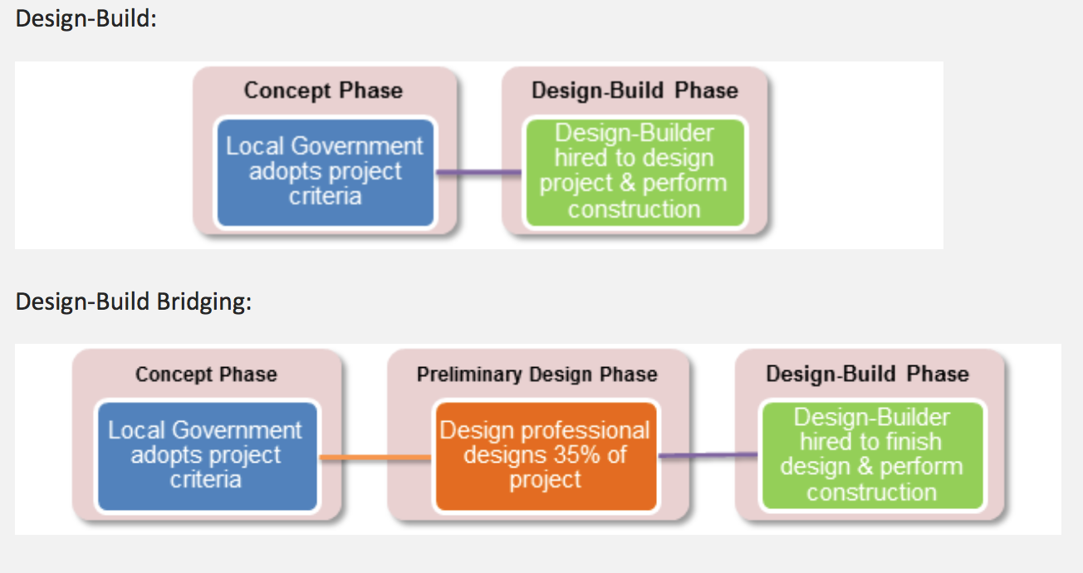
Bridged Delivery Systems
Combines Design-Bid-Build and Design-Bid
* Houston, Norma. "New Design-Build Bridging Construction Method – Design-Build "Lite" « Coates' Canons." Coates Canons. UNC School of Government, 06 Feb. 2014. Web. 25 Oct. 2015.
Notes:
Criteria: Define requirements in RFP – (For Alaska, it can be permitting, design for end-users, working with entities); considers time restraints; design build builds based on the criteria
Design Professional that helps with Preliminary Design Phase can not bid on project, but stands in to support owner.
Basically some details are done first and then the rest of the design, construction is done by design builder

Slide 10
Feedback
Any sharable experiences?
Thoughts?
We will be breaking out later to discuss more

